Slide 1
What’s the Reason for all the Wheezin’? Elisha McCoy, MD, FAAP Assistant Professor of Internal Medicine and Pediatrics Division Chief of Pediatric Academic Hospital Medicine Director of Quality and Health System Improvement

Slide 2
I have no financial disclosures.

Slide 3
Objectives
Define the clinical symptoms that encompass bronchiolitis
Briefly explain the pathophysiology of the disease
Name at least three viruses responsible for bronchiolitis
Define the months of the year when bronchiolitis is most common
List at least three risk factors for a more severe illness course
Describe the diagnosis of bronchiolitis and the utility of labs and images
Discuss the recommendations for treatment, pros and cons
Describe prevention strategies

Slide 4
A Case
A 4 month-old female presents with a 3 day history of low grade fever and runny nose. She has now developed a cough and has some trouble breathing at times. Her immunizations are up to date, and she is an only child. She has no known sick contacts, but she attends day care. On physical exam, her axillary temperature is 38.1 degrees Celsius, her respiratory rate is 50 per minute, she coughs frequently, and she looks quite ill. She has diffuse expiratory wheezes and mild rhinorrhea. The remainder of her physical exam is normal.

Slide 5
Case continued…

Slide 6
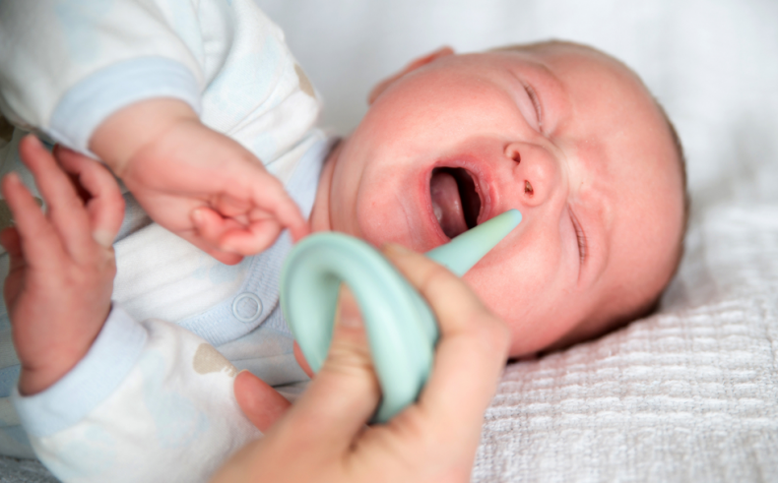
Bronchiolitis
Defined as:
Clinical syndrome occurring in children < 2 years of age
Characterized by upper respiratory symptoms (rhinorrhea)
Followed by lower respiratory infection with inflammation resulting in wheezing and/or crackles

Slide 7
Epidemiology
Disease of infants and children < 2 years of age
Seasonal – primarily Fall and Winter
Primarily caused by viruses
A leading cause of hospitalization in young children and infants
~ 100,000 admissions in U.S. each year
Estimated cost $1.73 billion
Hasegawa K, Tsugawa Y, Brown DF, Mansbach JM, Camargo CA Jr. Trends in bronchiolitis hospitalizations in the United States, 2000-2009. Pediatrics. 2013;132(1):28–36pmid:23733801

Slide 8
What causes bronchiolitis?
Bronchiolitis is a viral illness:
Respiratory Syncytial Virus (RSV) – most common cause
Rhinovirus – second most common
Others: parainfluenza, human metapneumovirus, influenza, adenovirus, coronavirus, human bocavirus
Virus | % Etiology
Respiratory Syncytial Virus | 59%
Rhinovirus | 9%
Parainfluenza | 1%
Human Metapneumovirus | 1%
Influenza | 2%
Human Coronavirus | 0
Miller EK, Gebretsadik T, Carroll KN, et al. Viral etiologies of infant bronchiolitis, croup and upper respiratory illness during 4 consecutive years. Pediatr Infect DisJ. 2013;32(9):950–955

Slide 9
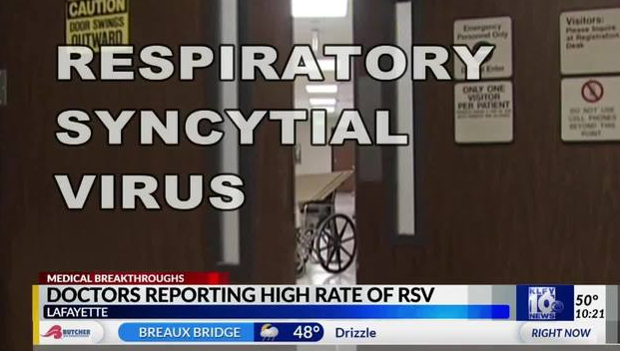
Respiratory Syncytial Virus
It is common!!
90% of children are infected with RSV by 2 years of age
40% of those will experience a LRTI
You can be infected more than once, and in the same season
Ralston SL, Lieberthal AS, Meissner HC, et al; American Academy of Pediatrics. Clinical practice guideline: the diagnosis, management, and prevention of bronchiolitis. Pediatrics. 2014;134(5). Available at:www.pediatrics.org/cgi/content/full/134/5/e1474

Slide 10
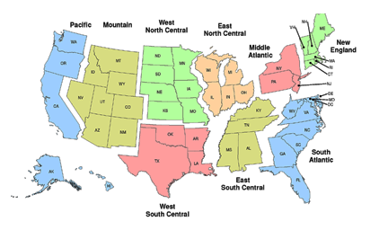
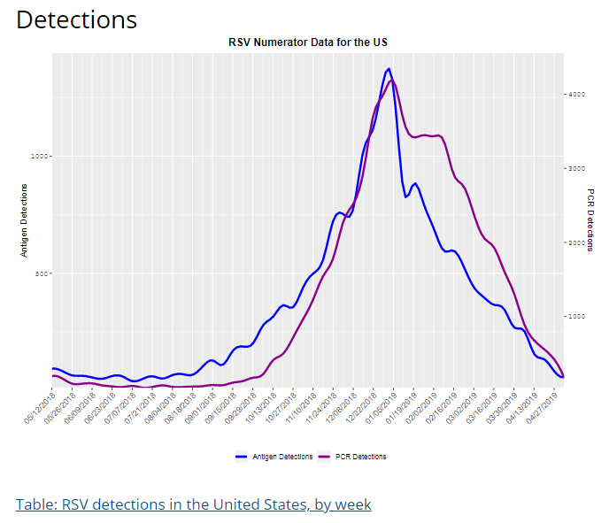
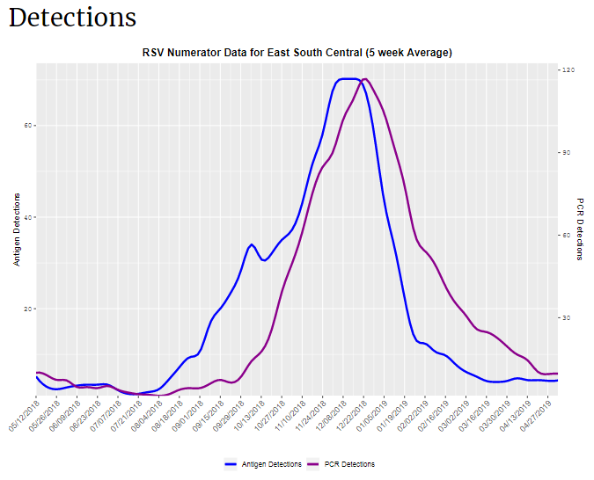
Seasonality
https://www.cdc.gov/surveillance/nrevss/rsv/index.html

Slide 11
Pathogenesis

Slide 12
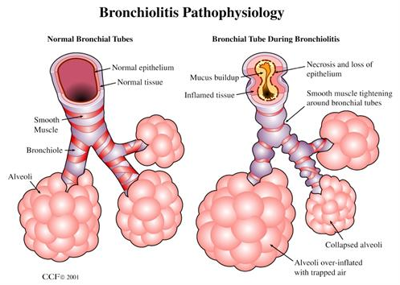
Pathogenesis
Viruses infect the terminal bronchiolar epithelial cells
Acute inflammation, edema, and necrosis of epithelial cells lining small airways
Increased mucus production
Ralston SL, Lieberthal AS, Meissner HC, et al; American Academy of Pediatrics. Clinical practice guideline: the diagnosis, management, and prevention of bronchiolitis. Pediatrics. 2014;134(5). Available at:www.pediatrics.org/cgi/content/full/134/5/e1474
www.uptodate.com

Slide 13
Symptoms of Bronchiolitis
Typically proceeded by URI symptoms
Fever – Typically ≤38.3˚C (101˚F)
Cough
Respiratory Distress
Increased respiratory rate
Retractions
Wheezing
Crackles
www.uptodate.com

Slide 14
Clinical Course
Self-limited disease
Clinical course dependent on age, severity of illness, risk factors, causative agent
URI symptoms
Days 2-3
Lower Respiratory Symptoms
Days 3-5
Peak Illness Symptoms
Resolution
With cough lingering 8-15 days

Slide 15
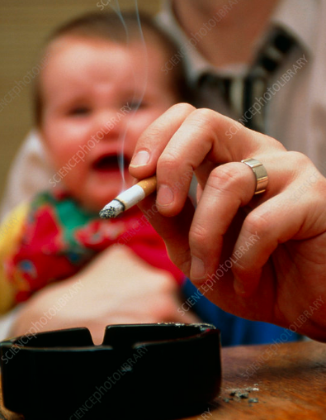
Risk Factors for Severe Disease
Prematurity (≤36 weeks gestation)
Low birth weight
Less than 12 weeks of age
Chronic lung disease, ex. Bronchopulmonary dysplasia
Anatomic defects of the airways
Congenital Heart Disease
Immunodeficiency
Neurologic Disease
Passive Smoking
Crowded household
Daycare attendance
Concurrent birth siblings
Older siblings
Being born within 2 months of the viral season
www.uptodate.com

Slide 16
Diagnosis
Bronchiolitis is a clinical diagnosis!!
Most important factors:
History and physical
Pulse Ox
Routine labs unnecessary
Chest X-ray is unnecessary
Notes:
History – focus on constellation of symptoms and discerning if another dx more accurate
Assessing for risk factors
Physical – focus on mental status, feeding and hydration
Respiratory rate – can be variable in small children, better to count for an entire minute

Slide 17
Why no labs?
Lab tests provide minimal value in bronchiolitis
Coinfection:
Risk of Bacteremia or meningitis - < 1-2%
Risk of UTI - < 1-2%
Consider in infants 30-90 days old unimmunized, severely ill appearing
Any child with an unusual, severe course of illness
Levine DA, Platt SL, Dayan PS, et al. Risk of serious bacterial infection in young febrile infants with respiratory syncytial virus infections. Pediatrics 2004; 113:1728.
Ralston S, Hill V, Waters A. Occult serious bacterial infection in infants younger than 60 to 90 days with bronchiolitis: a systematic review. Arch Pediatr Adolesc Med 2011; 165:951.
McDaniel CE, Ralston S, Lucas B, Schroeder AR. Association of Diagnostic Criteria With Urinary Tract Infection Prevalence in Bronchiolitis: A Systematic Review and Meta-analysis. JAMA Pediatr 2019.

Slide 18
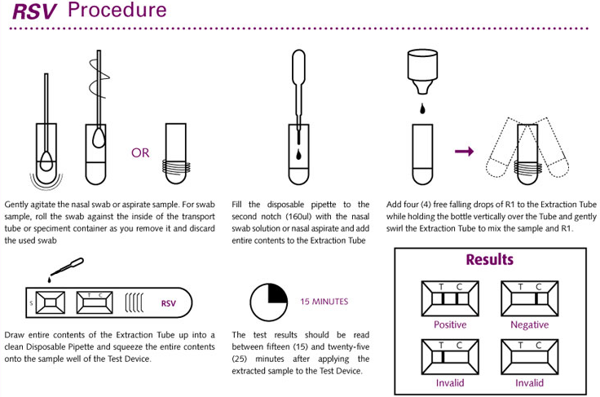
What about viral testing?
Options:
Antigen detection assays – performed on mucous
Sensitivity – 80-90%; seasonal dependence
Reverse transcriptase – polymerase chain reaction (RT-PCR)
Higher sensitivity than Antigen detection assays
PCR tests – designed to detect multiple viruses
Interpret with caution
No impact on clinical outcomes
May affect cohorting in hospitals
Bordley WC, Viswanathan M, King VJ, et al. Diagnosis and Testing in Bronchiolitis: A Systematic Review. Arch Pediatr Adolesc Med. 2004;158(2):119–126. doi:10.1001/archpedi.158.2.119
American Academy of Pediatrics. Respiratory Syncytial Virus. In: Kimberlin DW, Brady MT, Jackson MA, Long SS, eds. Red Book: 2018 Report of the Committee on Infectious Diseases. 31st ed. Itasca, IL: American Academy of Pedatrics; 2018: 682-5.
Notes:
Seasonal – If you test and it is not the typical season, high degree of false positives
PCR tests more common – Caution interpreting due to sensitivity of picking up viruses that are continuing to be shed sometimes weeks after acute infection – Not cause of current illness
Up to 25% of asymptomatic children test + with PCR tests
30% of children infected with RSV are co-infected with another virus – does not predict severity

Slide 19
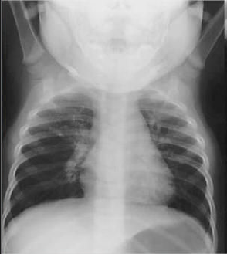
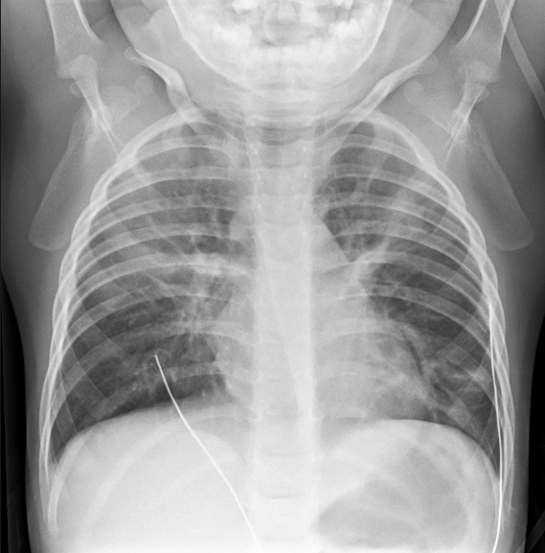
Why no CXR?
Typical CXR appearance:
Peribronchial cuffing
Atelectasis
No correlation with disease severity
Can lead to increased use of antibiotics
When to consider CXR?
Moderate to severe distress
Considering alternative diagnosis
Ralston SL, Lieberthal AS, Meissner HC, et al; American Academy of Pediatrics. Clinical practice guideline: the diagnosis, management, and prevention of bronchiolitis. Pediatrics. 2014;134(5). Available at:www.pediatrics.org/cgi/content/full/134/5/e1474
www.uptodate.com
Dawson KP, Long A, Kennedy J, Mogridge N. The chest radiograph in acute bronchiolitis. J Paediatr Child Health 1990; 26:209.
Notes:
Typically see peribronchial cuffing and atelectasis – mistaken for infiltrate and leads to antibiotics

Slide 20
Who gets admitted?
Infants who appear toxic, feeding poorly, are lethargic, or dehydrated
Moderate to severe respiratory distress
Nasal flaring; intercostal, subcostal, or suprasternal retractions, respiratory rate >70 breaths per minute; dyspnea; cyanosis
Apnea
Hypoxemia (SpO2 <95%) – interpret with other clinical signs

Slide 21
How we should approach treatment
Supportive! Supportive! Supportive!

Slide 22
How we approach treatment instead…

Slide 23
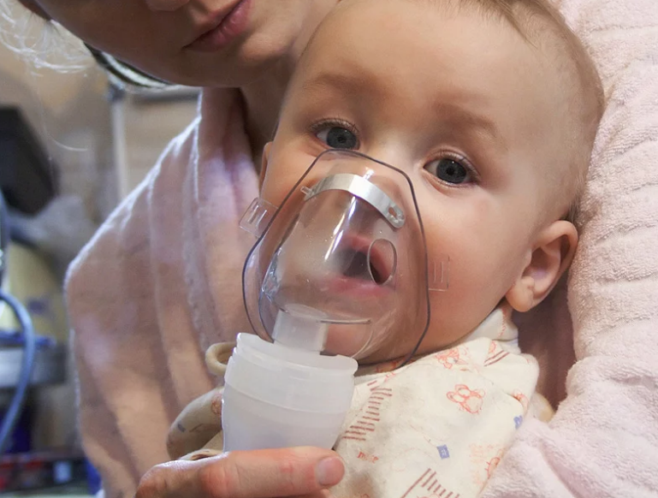
Bronchodilators
AAP does NOT routinely recommend:
Albuterol
Racemic Epinephrine
Multiple systematic reviews show no improvement in disease resolution, hospitalization, or length of stay
Some transient improvement in clinical score - subjective
May be considered as rescue medication
Ralston SL, Lieberthal AS, Meissner HC, et al; American Academy of Pediatrics. Clinical practice guideline: the diagnosis, management, and prevention of bronchiolitis. Pediatrics. 2014;134(5). Available at:www.pediatrics.org/cgi/content/full/134/5/e1474
Notes:
Small subset may be responders due to smooth muscle contraction – not substantial.
Risks: tremors, tachycardia, cost

Slide 24
Hypertonic Saline (3%)
Emergency Department
Should NOT be used
No reduction in hospitalizations
Hospitalized children and infants
Providers MAY administer
No reduction in Length of Stay
Ralston SL, Lieberthal AS, Meissner HC, et al; American Academy of Pediatrics. Clinical practice guideline: the diagnosis, management, and prevention of bronchiolitis. Pediatrics. 2014;134(5). Available at:www.pediatrics.org/cgi/content/full/134/5/e1474
Notes:
Physiologic evidence suggests that hypertonic saline increases mucociliary clearance in both normal and diseased lungs – presumed only – no literature to support

Slide 25
Steroids and Antibiotics
Steroids should NOT be administered
No physiologic benefit; may prolong viral shedding
Do NOT administer antibiotics
Except if there is a concomitant bacterial infection
UTI – 1-2%
Bacteremia – 1-2%
Ralston SL, Lieberthal AS, Meissner HC, et al; American Academy of Pediatrics. Clinical practice guideline: the diagnosis, management, and prevention of bronchiolitis. Pediatrics. 2014;134(5). Available at:www.pediatrics.org/cgi/content/full/134/5/e1474

Slide 26
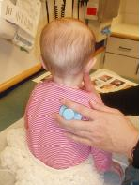
Chest Physiotherapy
AAP recommends NOT using CPT in children with bronchiolitis
Cochrane review – 9 randomized control trials
No clinical benefit using vibration or percussion, or passive expiratory techniques
Ralston SL, Lieberthal AS, Meissner HC, et al; American Academy of Pediatrics. Clinical practice guideline: the diagnosis, management, and prevention of bronchiolitis. Pediatrics. 2014;134(5). Available at:www.pediatrics.org/cgi/content/full/134/5/e1474

Slide 27
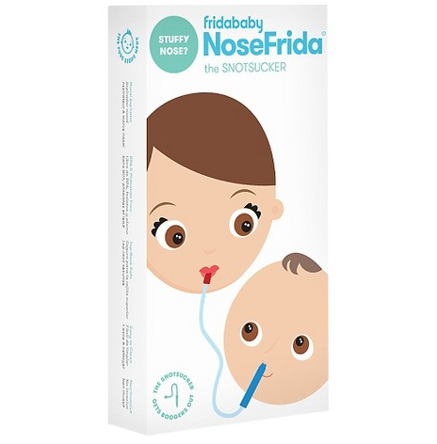
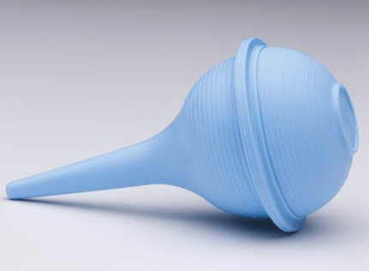
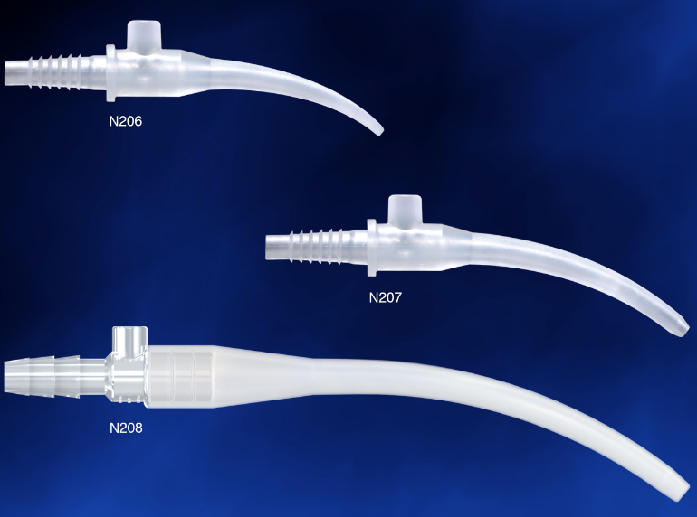
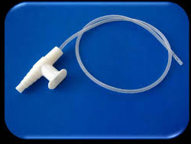
Suctioning
Define suctioning…
Deep nasal suctioning has been shown to increase length of stay
AAP – No definitive consensus statement
Mussman GM, Parker MW, Statile A, Sucharew H, Brady PW. Suctioning and length of stay in infants hospitalized with bronchiolitis. JAMA Pediatr. 2013;167(5):414–421pmid:23460088
Notes:
May produce edema – nasal obstruction

Slide 28
Supportive Care
Oxygen
Supplement to maintain O2 sats >90%
Transient hypoxemia - common in healthy infants
No evidence to support intermittent hypoxemia = adverse consequences
Continuous Pulse Oximetry
NOT recommended: accuracy, alarm fatigue, parent anxiety, false sense of security, increased LOS
Poor correlation between respiratory distress and oxygen saturation
High Flow Nasal Cannula
Ralston SL, Lieberthal AS, Meissner HC, et al; American Academy of Pediatrics. Clinical practice guideline: the diagnosis, management, and prevention of bronchiolitis. Pediatrics. 2014;134(5). Available at:www.pediatrics.org/cgi/content/full/134/5/e1474
Notes:
In infants and children with bronchiolitis, no data exist to suggest such increases (>90%) result in any clinically significant difference in physiologic function, patient symptoms, or clinical outcomes

Slide 29
Supportive Care
Fluids
Recommended for infants and children who are unable to maintain oral hydration
Nasogastric feeds
Isotonic fluids
No literature to support one over the other
Ralston SL, Lieberthal AS, Meissner HC, et al; American Academy of Pediatrics. Clinical practice guideline: the diagnosis, management, and prevention of bronchiolitis. Pediatrics. 2014;134(5). Available at:www.pediatrics.org/cgi/content/full/134/5/e1474

Slide 30
Preventive Measures
Hand hygiene
Use of personal protective equipment (gloves, gowns, masks)
Eliminate exposure to tobacco smoke
Breastfeeding until at least 6 months of age
Family education
Ralston SL, Lieberthal AS, Meissner HC, et al; American Academy of Pediatrics. Clinical practice guideline: the diagnosis, management, and prevention of bronchiolitis. Pediatrics. 2014;134(5). Available at:www.pediatrics.org/cgi/content/full/134/5/e1474
Notes:
Tobacco smoke increases morbidity and mortality
Breastfeeding decreases morbidity of resp infections
Education – 2-3 weeks of symptoms; other family members likely to get sick; prevention; newborns and exposure; decreased antibiotics

Slide 31
Questions???

